Slide 1
TSRI 教育性晶片下線流程
2020 年 9月 23日
Student Sih-Yun Chen
Professor Ming-Bo Lin

Slide 2
Flow Chart
Implementation
Verification
.v
RTL code
RTL Simulation
Lint Check
Code Coverage Analysis
Logic Synthesis
(DC)
_syn.v
Formal
Gate-level netlist
Gate-level Simulation
(pre-sim)
Static Timing Analysis
Power Analysis
Automatic
Place & Route
(ICC)
_pr.v
Formal
Post layout
Gate-level netlist
Gate-level Simulation
(post-sim)
Static Timing Analysis
Power Analysis
LVS
.gds
GDS layout
DRC
Transistor netlist
Tape out
Extraction
(下線晶片用檔)
Transistor-level Simulation
Transistor-level STA
Power Analysis
(包bounding pad)

Slide 3
ICC後步驟
Implementation
Add Bounding Pad
_merge.gds
LVS
lvs.rep
檢查correct
Qentry DRC
drc.rep
至http://www2.cic.org.tw/~shuttle/drc/下載可容許錯誤列表
TSRI下線申請
資料上傳
Test Pattern
V93000機台測試
產生測試vector file

Slide 4
RTL
run ncverilog
function simulation
nWave

Slide 5
RTL 不可合成 (DC不給過)
reset將所有register array歸零(用for即可)，不然DC合完會unknown。
for( i=0 ; i<=x ; i=i+y ) 這裡x跟y不可為變數。
always@(a) , a必須是此always block內有用到之變數。
同個變數不可放不同的always block內。(multiple driven problem)
不可有latch

Slide 6
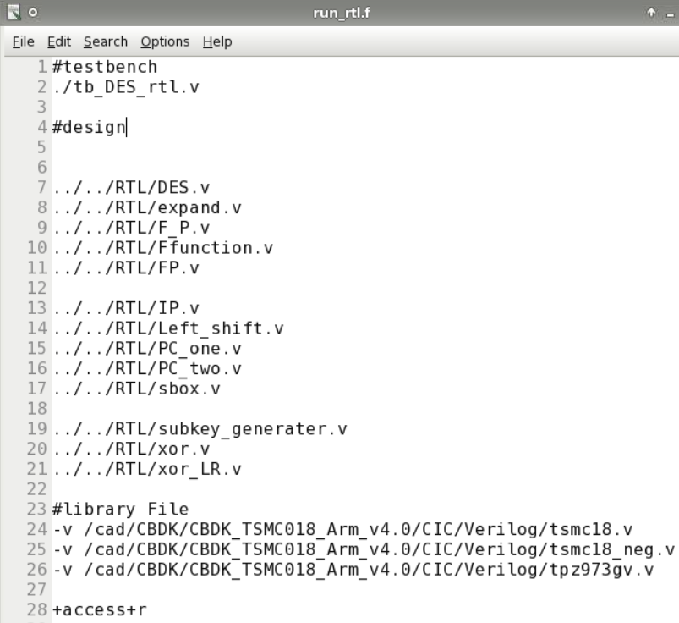
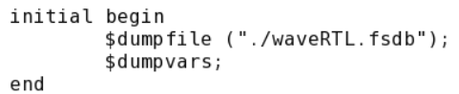
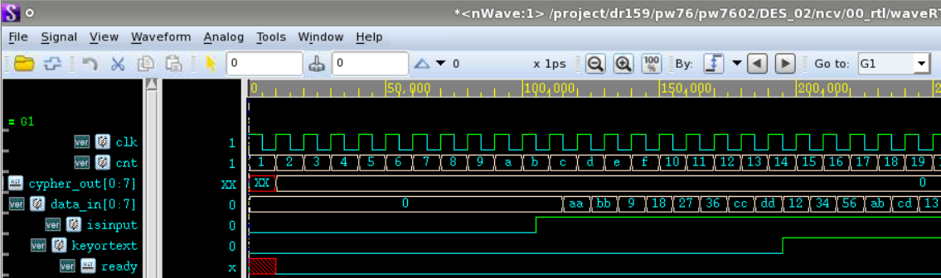
Run ncverilog
如果只改部分code
ncverilog只會重新合成改code的地方
加+clear會清掉所有之前合成的
全部重新合成，不然可以會有bug
適合小電路 >Rncverilog your_tb.v your_design00.v your_design01.v +access+r +clear
適合大電路 >Rncverilog –f run.f
為了看波形檔 tb.v必須加入:
為了可以產生波形
你的測試檔tb.v
觀察波型
你的所有設計.v檔
RnWave
選擇欲觀察的波形
2
1
開啟 *.fsdb
DC 及 ICC 再放即可

Slide 7
DC
design compile
logic synthesis

Slide 8
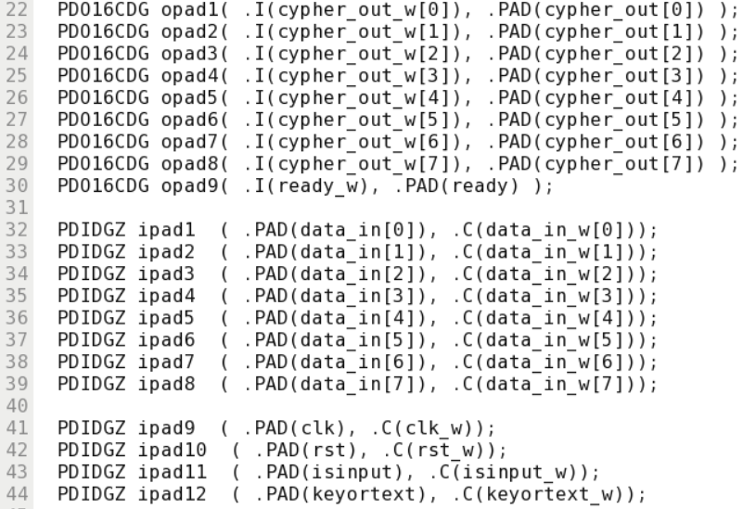
包IO pad (T18)
cad/CBDK/CBDK_TSMC018_Arm_v4.0/CIC/doc
(CBDK = Cell-Based Design Kit)
RTL
RTL
DC
DC
包IO pad
PAD
C
I
PAD
包io pad
PDIDGZ
PD016CDG
Design Setup
PAD
C
I
PAD
dv環境設定
PDIDGZ
PD016CDG
數字代表driving能力
通常選>16以上(16,24..)
太小跑不到100 MHz以上
read file
PAD
C
I
PAD
read file
PDIDGZ
Your
Design
PD016CDG
constraints
…..
…..
set environment
PAD
C
I
PAD
PDIDGZ
PD016CDG
set constraints
PAD
C
I
PAD
PDIDGZ
PD016CDG
PAD
C
I
PAD
compile
PDIDGZ
PD016CDG
analysis
report
TOP cell
ICC
ICC

Slide 9
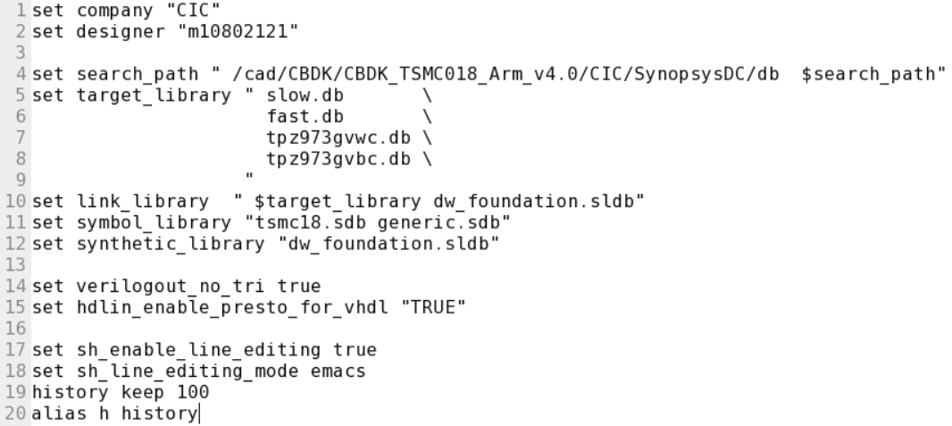
Rdv - Design Setup
只能在有.synopsys_dc.setup檔的資料夾下run Rdv (or dc_shell -gui)
RTL
RTL
DC
.synopsys_dc.setup (0.18um TSMC/ARM為例)
DC
包IO pad
包io pad
Design Setup
dv環境設定
read file
core library: slow.db (Max delay-setup time)
fast.db (Min delay-hold time)
IO pad library: tpz973gvwc.db
tpz973gvbc.db
bounding pad: tpb*
read file
合成mapping用
wc=worst case
查詢lib資料時使用
bc=best case
constraints
set environment
($:變數內容值)
Synopsys內建的
set constraints
產生schematic用
design ware library的現成IP(例sin, cos…)
(path: cad/synopsys/synthesis/cur/dw/doc/datasheets)
compile
wc v.s. bc
Name | Temp | Volt
slow | 125 | 1.62
typical | 25 | 1.8
fast | -40 | 1.98
analysis
report
-10%
補充1:
.18TSMC是由ARM提供cell library
.18UMC是由Faraday(智元科技)提供
補充2:
.lib檔 -> Cadence
.db檔->Synopsys
+10%
ICC
ICC

Slide 10
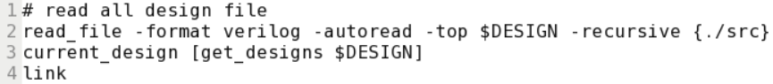
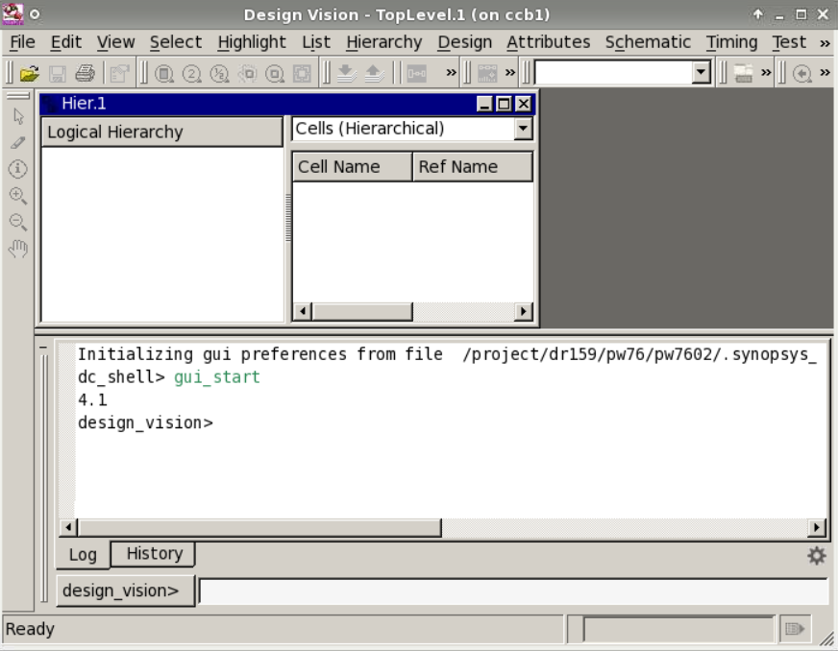
Read File - Scripts
RTL
RTL
DC
DC
包IO pad
包io pad
Design Setup
此時會報.v檔是否有語法上的錯誤 (DC不可合)
檢查是否有latch
dv環境設定
read file
read file
constraints
set environment
set constraints
compile
analysis
report
source scripts
ICC
ICC

Slide 11
Set Environment
RTL
RTL
DC
DC
1
set_operating_conditions
包IO pad
包io pad
Design Setup
2
set_input_delay
4
set_load
dv環境設定
read file
read file
3
set_driving_cell
constraints
set environment
create_clock
6
set_wire_load_model
set constraints
5
set_output_delay
My design
compile
analysis
report
ICC
ICC

Slide 12
Set input delay and output delay
RTL
RTL
DC
DC
A design
My design
B design
包IO pad
包io pad
FF1
FF2
FF3
FF4
Design Setup
dv環境設定
read file
3ns
7ns
2ns
8ns
read file
10ns
constraints
set environment
clk
set constraints
compile
set_input_delay –clock clk –max 3 [get_ports in]
set_output_delay –clock clk –max 8 [get_ports out]
analysis
report
ICC
ICC

Slide 13
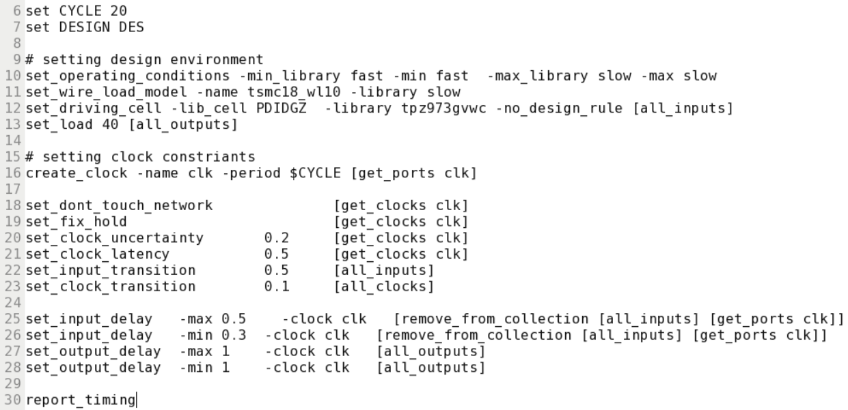
Set Environment - Scripts
20 ns = 50 MHz
RTL
RTL
因APR route後才會有真正的net delay
這裡必須先設wire load model for net delay
請設wl10 (誤差最小)
DC
包完IO pad的TOP cell name
DC
包IO pad
包io pad
Design Setup
V93000機台的load 是 40
T18的driving cell是PDIDGZ
dv環境設定
read file
read file
constraints
set environment
clock uncertainty = clock skew 通常設0.1~0.3
= clock network latency 內部delay 通常設1~3
input transition固定設0.5 (TSRI V93000機台)
set constraints
clock transition 通常設0.1~0.3
跟前後design之間的delay
compile
input delay同常設1/3~1/2 period
analysis
report
檢查timing 是否 slack>=0
ICC
ICC

Slide 14
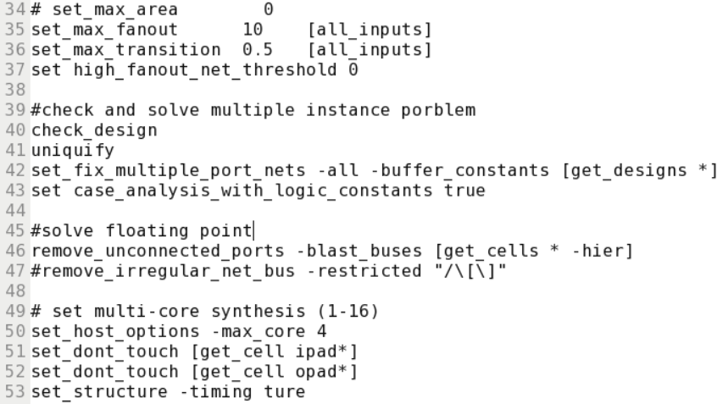
Set Constraints
RTL
RTL
DC
DC
包IO pad
包io pad
檢查multiple instance problem
uniquify command一下即可修正此problem 但會因此將net 及cell 名稱都打亂
Design Setup
dv環境設定
read file
read file
constraints
set environment
set constraints
用多核心跑合成，提升合成速度。
compile
analysis
report
如果為了debug要保留內部pin原名稱
請下
set compile_preserve_subdesign_interfaces true
ICC
ICC

Slide 15
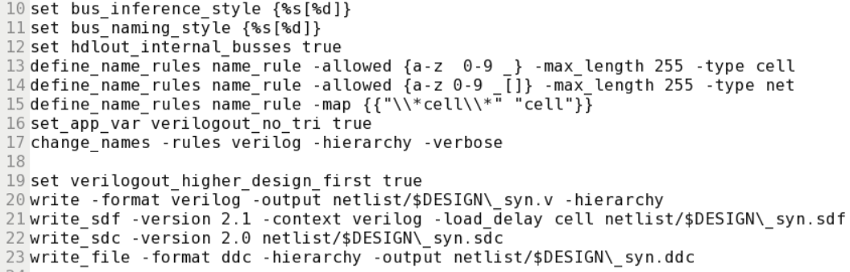
Compile
RTL
RTL
DC
DC
包IO pad
包io pad
Design Setup
dv環境設定
read file
Change naming rule
read file
constraints
set environment
set constraints
DC跑完會產生以下的檔:
_syn.v :合成完的gate-level netlist (run function simulation)
.sdf :會有cell的setup/ hold time資訊
.ddc
.sdc :會有你下的constraints
非常不建議用compile_ultra command,常常合成出來的function會fail
compile
analysis
report
ICC
ICC

Slide 16
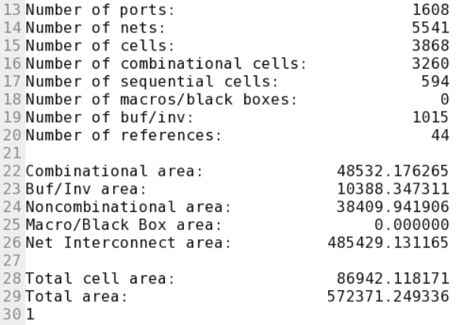
計算gate counts
RTL
RTL
cad/CBDK/CBDK_TSMC018_Arm_v4.0 \
/CIC/doc
找NAND21的datasheets資訊
T18的NAND21面積約是9.9792 um²
DC
DC
包IO pad
包io pad
Design Setup
dv環境設定
chip cell area
read file
gate counts =
read file
NAND21 area
constraints
set environment
set constraints
compile
analysis
report
cell area 不是 total area
ICC
ICC

Slide 17
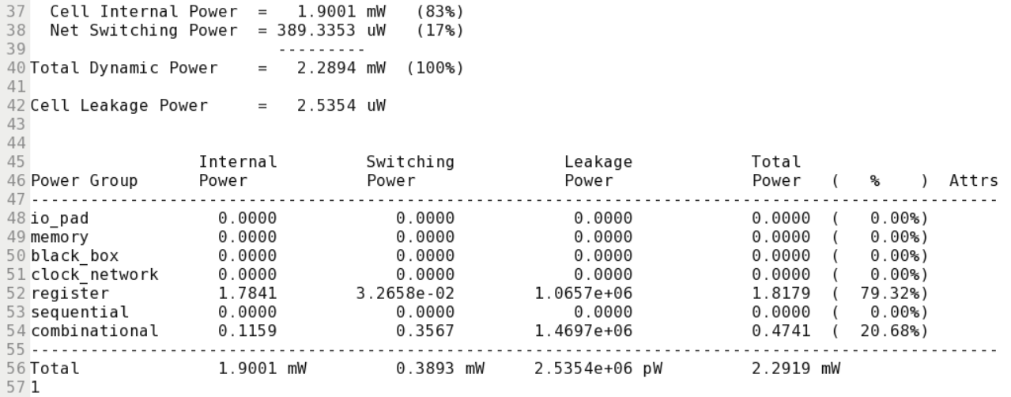
report_power
Dynamic power:
(1)Switch power
(2)Internal power
1. short circuit : pmos and nmos 0<->1會有瞬間兩個都導通
2. charging internal load 充放電
RTL
RTL
DC
DC
包IO pad
包io pad
Design Setup
dv環境設定
read file
read file
constraints
set environment
set constraints
通常core power都10 mW以下
compile
analysis
report
ICC
ICC

Slide 18
report_timing
RTL
RTL
檢查setup time >report_timing
修setup time violation >compile –incremental_mapping –map_effort high
檢查hold time >report_timing –delay_type min
修hold time violation >compile –inc –only_hold_time
setup time and hold time 的 slack都必須>=0 ! (最好不要剛好=0)
DC
DC
包IO pad
包io pad
Design Setup
dv環境設定
read file
read file
constraints
set environment
set constraints
compile
analysis
report
ICC
ICC

Slide 19
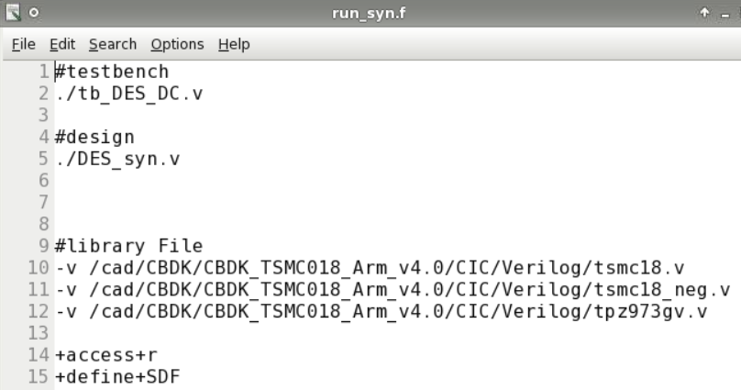
DC simulation
Rncverilog –f run_syn.f
RnWave
如果跑不對，可能要修RTL code，從nWave看波形哪裡錯了，很有可能出錯會是latch或是combinational block的地方。

Slide 20
ICC
IC compile
APR

Slide 21
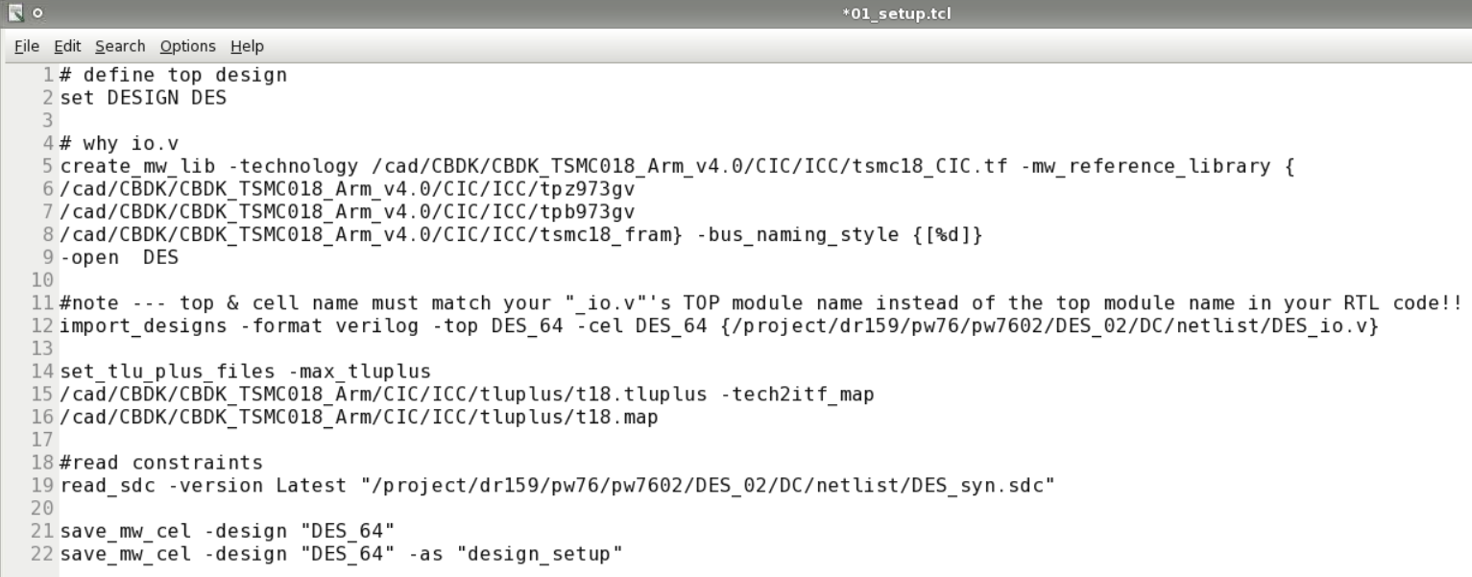
Design Setup
DC
一樣必須在有.synopsys_dc.setup檔案下的資料夾才能 run Ricc_shell -gui
Create library
Import design (*_syn.v) : 將用DC合成完的netlist檔讀進來
TLU+
Read constraints (.sdc)
ICC
Design Setup
Design Planning
Placement
.tf是製程參數檔 裡面有關於每層metal的相關資訊 等等
CTS
tpz*是IO pad; tpb*是 bounding pad
自己命名library name
FRAM是假layout 精簡版的layout只有metal1 layer以上(保護製程機密)
Routing
DFM

Slide 22
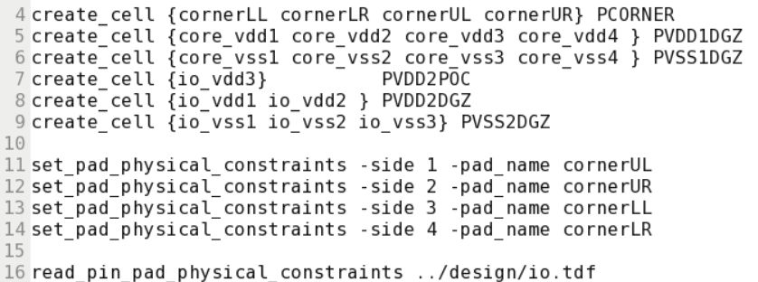
Create Starting Floorplan (T18)
DC
Create physical-only pad cells
Specify pad cell locations (io.tdf)
ICC
Design Setup
DGZ: Digital
1: core pad
2: IO pad
Design Planning
TSMC有一個IO要用POC
Floor Plan
Course placement
設定四個corner
congestion
power network
補充
IO power pad 擺放要四邊平均且交錯擺放。
(Shielding)
IR drop
Placement
CTS

Slide 23

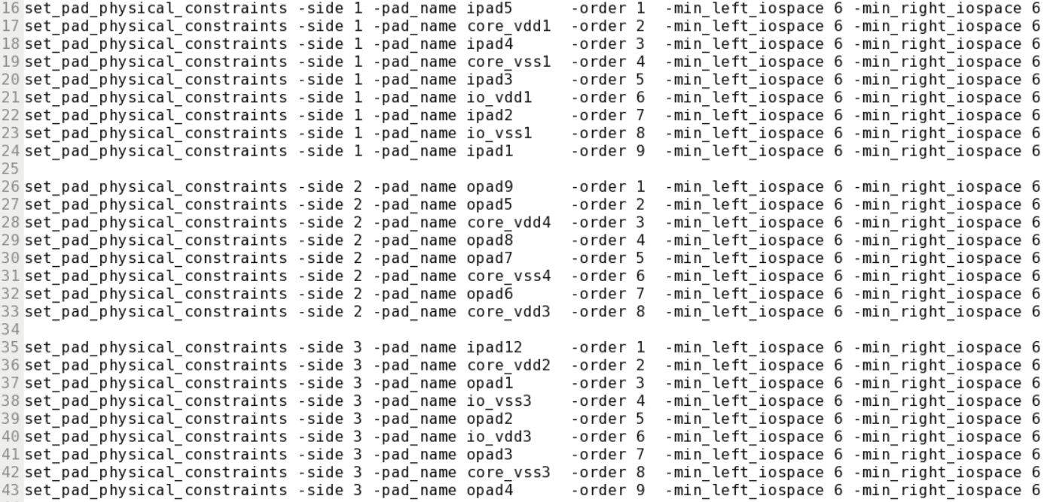
io.tdf
1 2 3 4 5
Side 2
cornerUL
cornerUR
1 2 3 4 5
core area
1 2 3 4 5
DC
ICC
Side 1
Side 3
Design Setup
cornerLL
cornerLR
1 2 3 4 5
min_left_iospace
min_right_iospace
Side 4
Design Planning
Floor Plan
Course placement
congestion
power network
IR drop
Placement
CTS

Slide 24
Create Starting Floorplan (T18)
DC
Initialize the floorplan
Insert pad filler cells
ICC
core跟pad的空隙=長power ring的地方 ; 注意U18一定要>=80 um
Design Setup
must be from bigger to smaller
Design Planning
standard cell area + macro cell area
Floor Plan
core utilization =
pad間有空隙會導致開路，必須放 pad filler cells接起來。
core area
Course placement
congestion
power network
IR drop
Placement
CTS

Slide 25
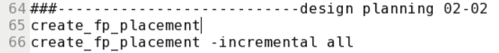
Course Placement
DC
只是初步的擺放(會在chip外)
ICC
Design Setup
timing優化
Design Planning
Floor Plan
Course placement
congestion
power network
IR drop
Placement
CTS

Slide 26
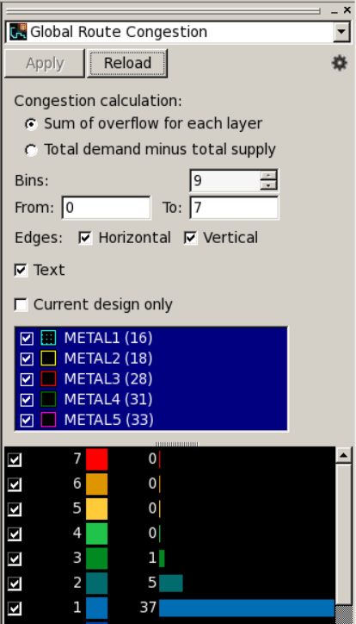
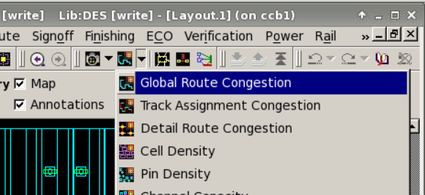
Analyze Congestion
DC
分析congestion狀態，點選Global Route Congestion視窗，再按下reload。
越紅色表示越嚴重。
通常layer 1-3可忽略，layer 4-5可能需要改善。
ICC
Design Setup
Design Planning
Floor Plan
Course placement
congestion
power network
IR drop
Placement
CTS

Slide 27
Optimize Congestion
DC
觀察發生位置:如果在standard cell的地方，可以等placement步驟解決。
如果在macro附近，可以增加macro附近的空隙:
>set physical_hard_keepout_distance 10
>set_keepout_margin –type hard –outer {10 0 10 0} RAM5
或是降低core utilization
ICC
Design Setup
加大距離
Design Planning
Floor Plan
Course placement
congestion
power network
IR drop
Placement
CTS

Slide 28
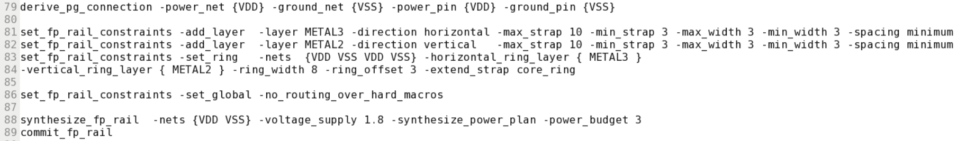
Synthesis Network Power
DC
長power ring/ power strap
水平:metal3 垂直:metal2
ICC
Design Setup
3:水平 2:垂直
Design Planning
Floor Plan
分析IR drop
Course placement
congestion
power network
IR drop
Placement
CTS

Slide 29
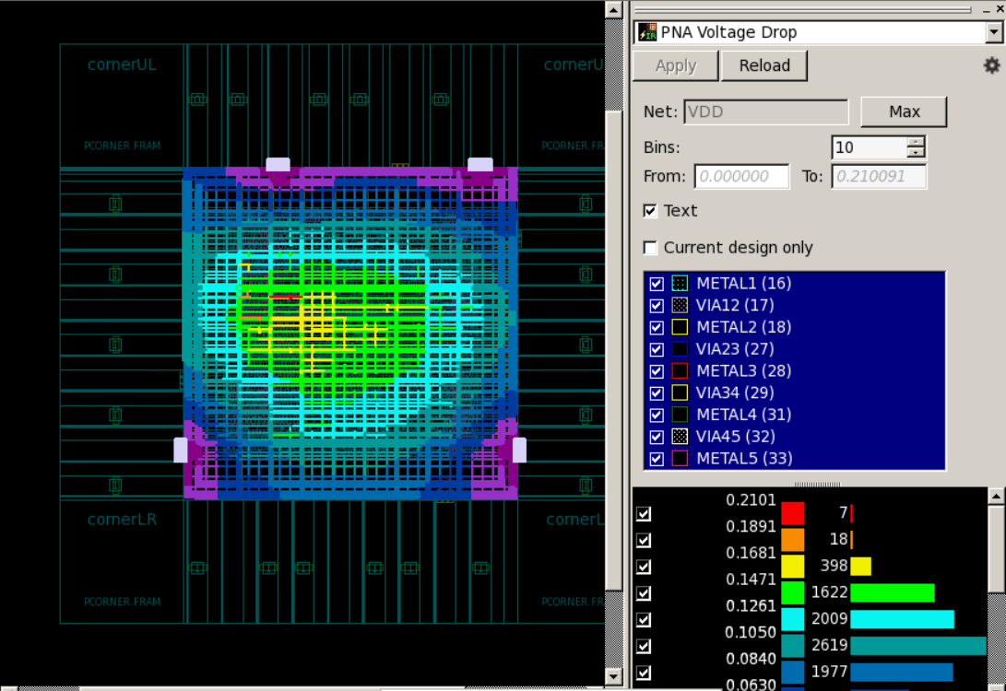
Analyze IR drop
DC
越紅色越嚴重
單位 :mV
不能超過10% 的VDD(例1.8V*10%=0.18V=180mV)
ICC
Design Setup
Design Planning
Floor Plan
Course placement
congestion
power network
IR drop
Placement
CTS

Slide 30
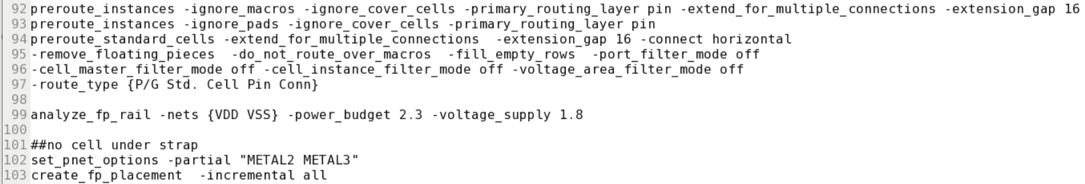
Synthesis Network Power
DC
將power ring連接至power pad
長power rail
再分析一次IR drop
ICC
gap是指兩個VDD/VSS的距離
Design Setup
Design Planning
Floor Plan
Course placement
設定strap下不要擺放standard cells
congestion
power network
IR drop
Placement
CTS

Slide 31
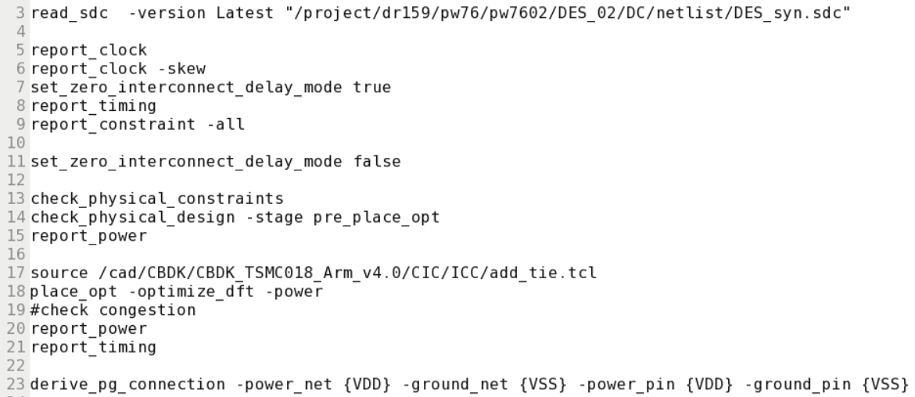
Placement
在CTS前一律都是用.sdc的constraints
DC
ICC
Design Setup
先將delay設為0查看constraint狀態，transition(推動力) violation可以先忽略，等CTS解決
Design Planning
Placement
確認之前的步驟都沒錯，檢查error是0, warning沒關係
CTS
重新改scan chain因為真正placement後排列與DC不同
source完warning很多是正常，可忽略
再檢查一次congestion
Routing
slack>=0
確認將VDD VSS都接到power pad
DFM
補充
tie cell是指將常數0或1的pin不接到VDD或VSS，而是接tie cell(較穩定)
Export

Slide 32
Placement – congestion problem
DC
如果有congestion problem:
如果slack<0請下 >refine_placement –perturbation_level high
> psynopt
否則下 >refine_placement
或 >refine_placement –congestion_effort low|medium|high
記住: 先修congestion再修timing
修timing下 >psynopt
或 >place_opt
ICC
Design Setup
Design Planning
Placement
CTS
Routing
DFM
Export

Slide 33
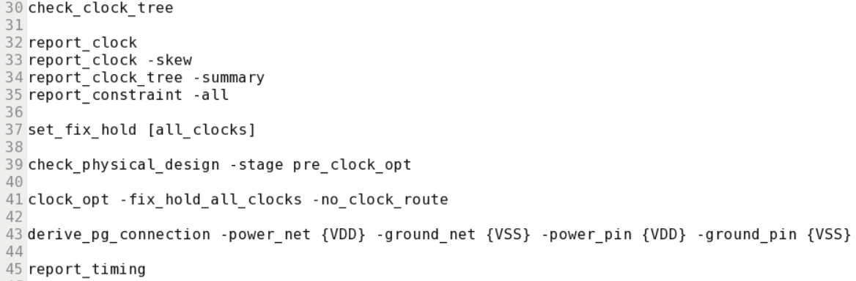
CTS – Clock Tree Synthesis
DC
Inserts buffers to meet skew(uncertainty), latency and transition(推動力) goals.
CTS前都是吃.sdc來分析,CTS後便是實際加buffers的結果。
亦可以修正hold time violation.
ICC
Design Setup
Design Planning
Placement
transition violation可以忽略(推動力問題)CTS後會改善
CTS
修hold time
檢查CTS前的步驟是否 0 error
Routing
將新create的buffers連接power pad
DFM
Export

Slide 34
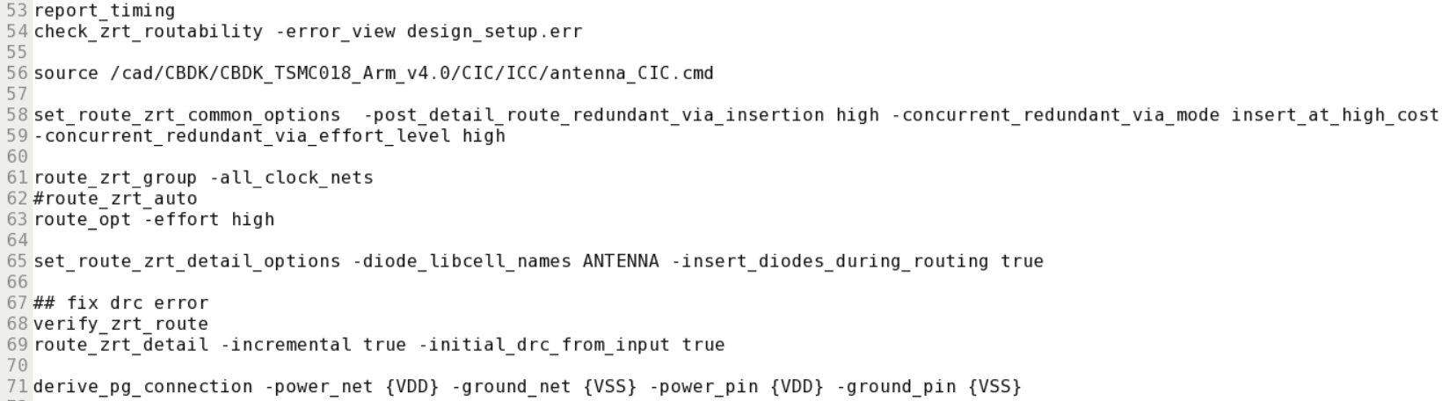
Routing
DC
確認routing前沒error,注意這error/warning在IO pad內可忽略!
ICC
Design Setup
auto route雖然較快但不建議，建議使用route_opt
Design Planning
檢查antenna rule (U18製程則無此步驟)
Placement
CTS
redundant via: 防止製程飄移，打double vias
T90,T18,U18 都是HVH
M1,M3 … :Horizontal
M2,M4 … :Vertical
Routing
DFM
Export

Slide 35
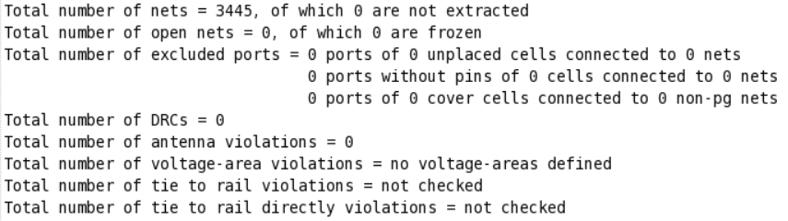
Check DRC rules
DC
ICC
Design Setup
Design Planning
Placement
如open nets以及DRC violations:
確認執行過(command) >verify_zrt_route
(gui) Route >Detail Route >√Incremental routing √Initial DRC from input cell
(gui) OK
如果還是無法解決，請刪掉所有route重新下route_opt
(gui) Route >Delete Route > √ Detailed route √Global route
(command) >route_opt –effort high
CTS
Routing
DFM
Export

Slide 36
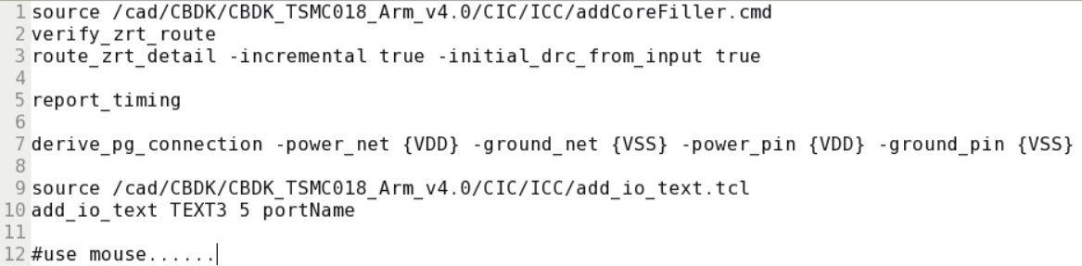
DFM – Design For Manufacturing
DC
目的: 增加晶片製作良率。
方式: 加入core filler平均chip density即可增加良率。
ICC
Design Setup
加入core filler cells
Design Planning
加入filler cells後可能會有route DRC violation,故必須再檢查一次
Placement
自動加text
3:打在metal 3的text
CTS
Routing
DFM
Export

Slide 37
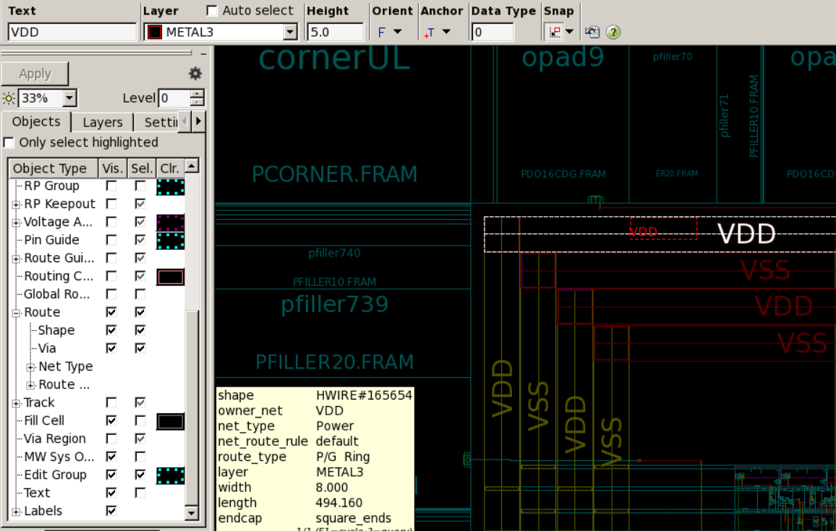
打text
DC
打text : VDD VSS (T18) / VCC GND (U18)
VDD及VSS各打一個就好
ICC
4
輸入VDD/ VSS
5
不要選Auto select 自己選擇layer, 大小輸入5.0
Design Setup
Design Planning
2
選Apply
3
6
Placement
按shift+t
在VDD打VDD,VSS打VSS
CTS
Routing
DFM
Export
1
Text vis.要打勾

Slide 38
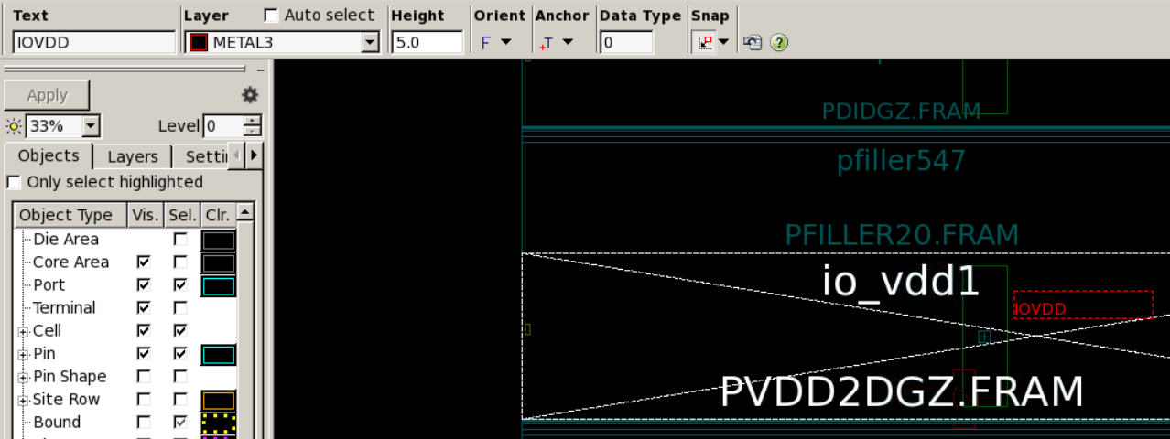
打text
DC
打text : IOVDD IOVSS (T18) / IOVCC IOGND (U18)
IOVDD及IOVSS各打一個就好
注意!一定要打在+上面!
ICC
Design Setup
4
輸入IOVDD 及IOVSS
5
不要選Auto select 自己選擇layer, 大小輸入5.0
Design Planning
Placement
2
選Apply
CTS
3
按shift+t
6
打在io vdd 及io vss上
一定要打在+上
Routing
DFM
Export
1
Pin vis.要打勾

Slide 39
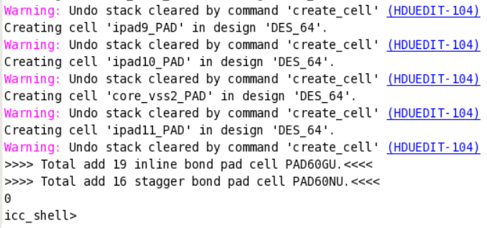
Add Bounding Pad
DC
ICC
注意!此步驟run結果會是0，而且有undo的warning都請忽略!
確認完成方式:將level調成1,即可觀察bounding pad是否有加上去。
Design Setup
Design Planning
Placement
CTS
Routing
DFM
Export

Slide 40
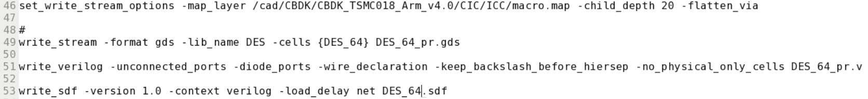
Export
DC
ICC
Design Setup
Design Planning
輸出檔案以及建議名稱:
*_pr.gds 將作Tape Out的步驟檔後測DRC。
*_pr.v 拿來跑function simulation(post-sim) 及LVS比對。
*_pr.sdf 會有cell的setup/ hold time資訊。
pr表示APR跑完的結果，與DC跑完的_syn作區別。
Placement
CTS
Routing
DFM
Export

Slide 41
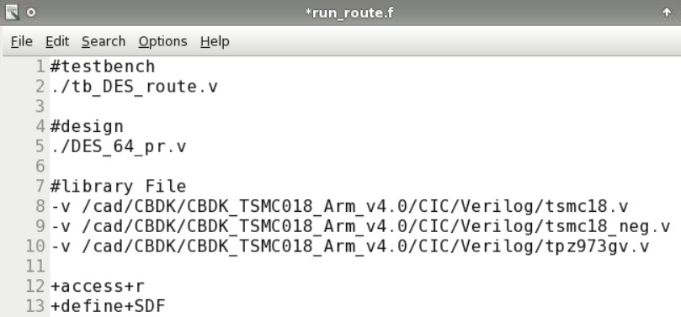
Post Simulation
Rncverilog –f run_route.f
RnWave

Slide 42
Tape Out & Qserver
DRC
LVS

Slide 43
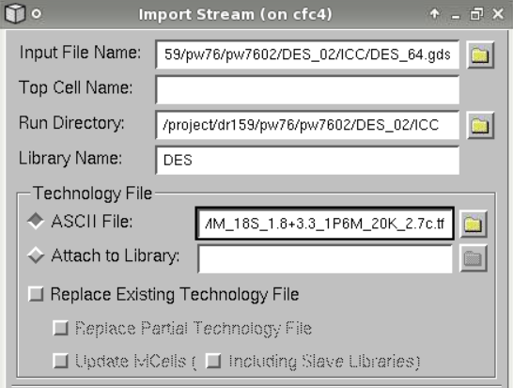
Add Bounding Pad(T18)
RTL
> Rlaker &
(GUI) File >Import >stream …
DC
ICC
ICC跑完的.gds檔
Add Bounding Pad
之前Lib名稱
LVS
/PDK/T18/Laker/Laker_MM*_2.7c.tf
Qserver
DRC

Slide 44
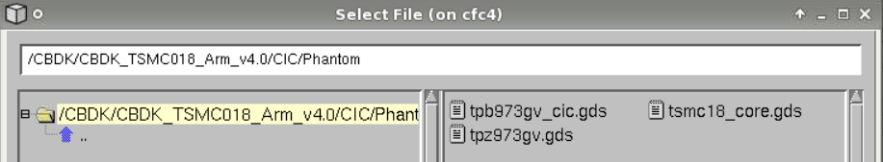
Add Bounding Pad(T18)
RTL
File >Import >stream …
注意! 此步驟千萬不要open著layout, 會lock住無法import
DC
ICC
Add Bounding Pad
LVS
依序加入:
tsmc18_core.gds
tpz973gv.gds
tpb973gv_cic.gds
Qserver
DRC

Slide 45
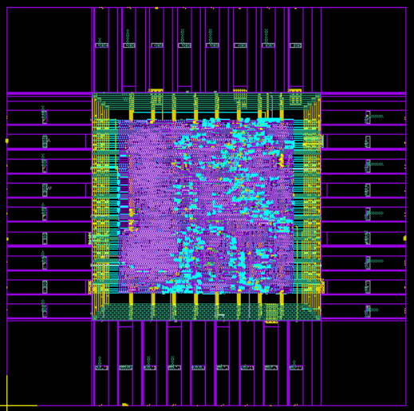
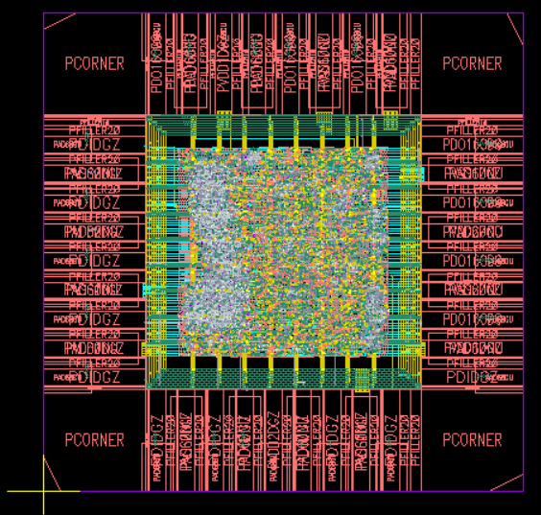
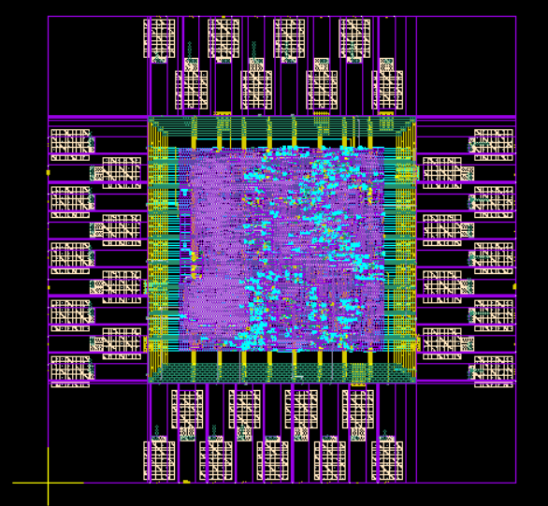
Add Bounding Pad(T18)
RTL
觀察是否成功:
(GUI) open > … 選你的layout
按 shift+f and ctrl+f 切換觀察bounding pad是否加上
DC
ICC
Add Bounding Pad
import前
LVS
shift+f
Qserver
DRC
ctrl+f
import成功後

Slide 46
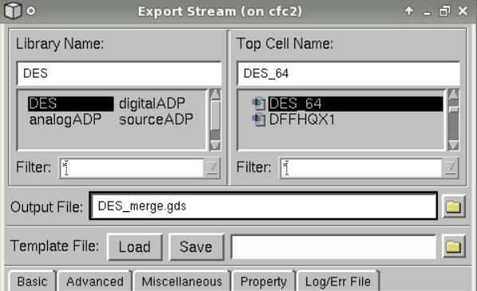
Add Bounding Pad(T18)
RTL
(GUI) File >Export >stream …
建議名稱*_merge.gds
這個GDS檔將會拿去做DRC驗證及LVS比對，也是將上傳至TSRI的最終下線晶片檔。
DC
ICC
Add Bounding Pad
LVS
Qserver
DRC
命名新名稱,建議*_merge.gds

Slide 47
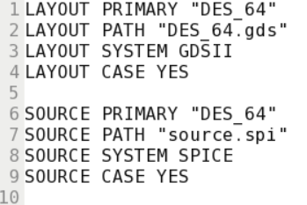
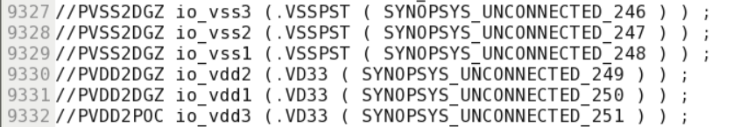
LVS
修改T18_LVS_CB.rule
RTL
>mkdir verify 創建資料夾
>mkdir lvs
>cd ~/lvs
>cp your_path/*_merge.gds . 將最終版的GDS檔copy過來
>cp your_path /*_pr.v . 將ICC合成完的.v檔copy過來
將*_pr.v所有的IOVDD IOVSS註解掉 (很重要一定要做) *記住:先註解掉再轉檔*
將.v檔轉成.spi
> Rv2lvs -64 –v *_pr.v –l tsmc18_lvs.v –l tpz973gv_lvs.v –l tpb973gv_lvs.v \
–s tsmc18_lvs.spi –s tpz973gv_lvs.spi –s tpb973gv_lvs.spi \
–s1 VDD –s0 VSS –o source.spi
修改T18_LVS_CB.rule檔
比對LVS
> Qcalibre –lvs -64 –spice layput.spi –hier –turbo_all –auto T18_LVS_CB.rule
在LVS_result內查看lvs.rep檔 確認correct (將上傳至TSRI)
add bounding pad完的GDS
DC
ICC
剛剛Rv2lvs的output檔名稱
Add Bounding Pad
LVS
ICC跑完的.v檔
請確認資料夾底下有這些檔案，沒有的話
請至學長姊的資料夾copy:
tsmc18_lvs.v
tpz973gv_lvs.v
tpb973gv_lvs.v
tsmc18_lvs.spi
tpz973gv_lvs.spi
tpb973gv_lvs.spi
Qserver
DRC
-o表示要output的檔案名稱

Slide 48
Qentry DRC – 真layout DRC
RTL
由於製程layout不公開，CBDK的layout都只有m1 layer以上(Phantom)
，故必須上傳至Qserver換成完整layout跑DRC verification.
> cd ~/verify
> mkdir drc
> cd drc
> cp your_path/*_merge.gds . 將tape out的GDS檔複製過來
> Qentry –M DRC –tech TSMC18 –f *_merge.gds –c TSMC18 –i TSMC18 \
–addTagCell –addDummyCell
> showq
直到你的帳號消失，表示完成。
將DRC_result底下含DRC.db檔先copy進自己的目錄下
DC
ICC
Add Bounding Pad
LVS
addTagCell:
晶片左下角的記號，辨認晶片方向
addDummyCell : (U18不加)
加入dummy cells，均勻chip density
Qserver
DRC

Slide 49
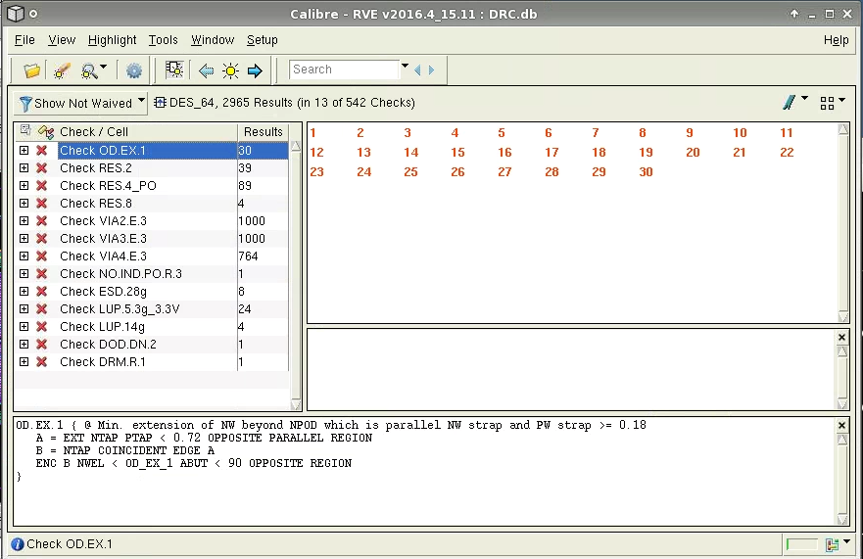
DRC
RTL
>Rlaker
(GUI) File >Import >stream …
(GUI) Open> … 選你的layout
(GUI) Verify >Calibre >Start RVE
(GUI) 選DRC.db檔
至TSRI下載DRC可容許錯誤列表(假錯list)
確認完error皆為可容錯，截圖。
上傳檔案是DRC.rep
DC
ICC
Add Bounding Pad
LVS
Qserver
DRC

Slide 50
TSRI V93000
test pattern
vector file
腳位

Slide 51
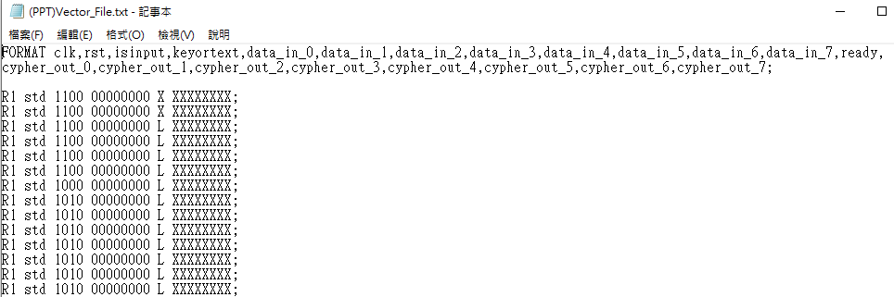
Vector file
注意FORMAT的順序一定要跟下面的順序一樣。
用RTL或DC跑完的.v檔產生皆可。
輸入皆為1及0.
輸出則為H/L/X.
1/0/H/L/X 會在timing file中定義 (timing file不用準備)
範例如下:

Slide 52
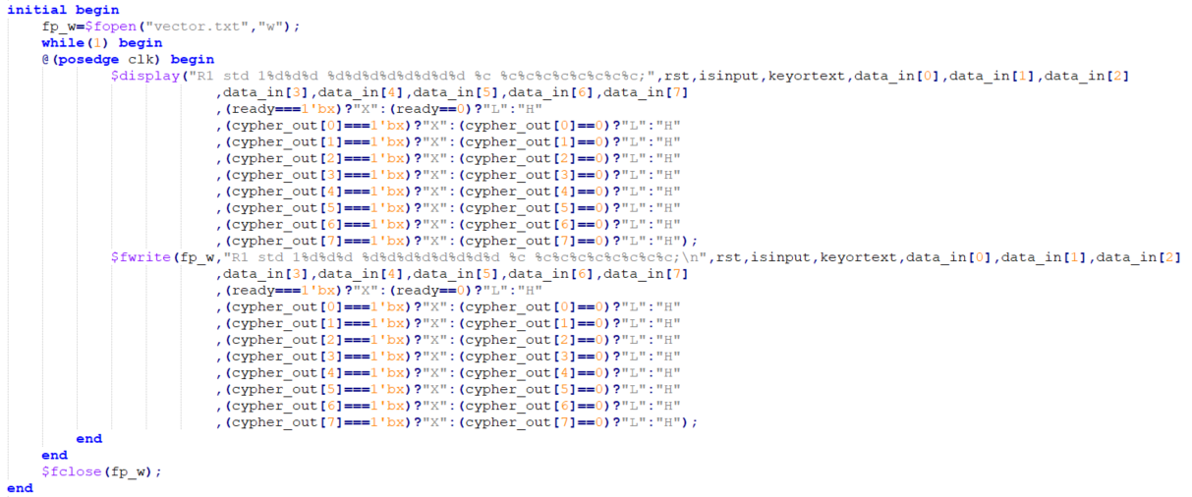
產生vector tb參考

Slide 53
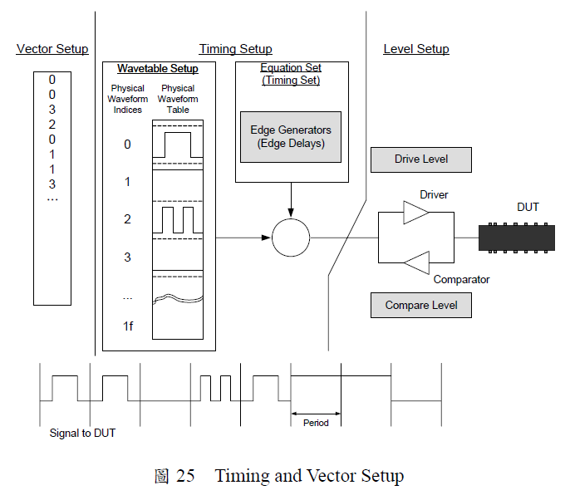
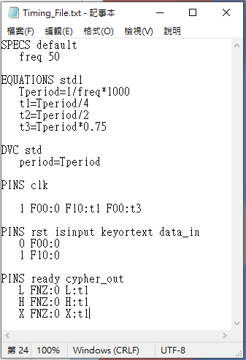
Timing file (不用準備)
圖片出處: Digital Chip Testing with Agilent 93000 SOC Series (上)

Slide 54
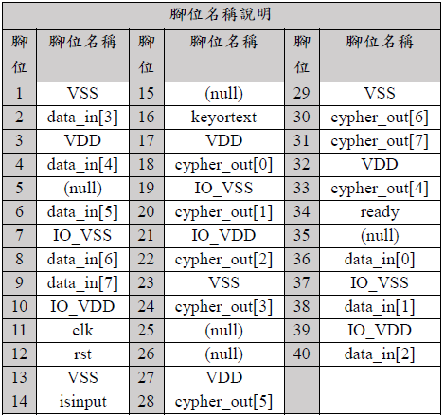
Prepare for DUT Board Connection

